Slide 1

Questions
Write a program to check whether a number is positive.
Write a program to check whether age is 18 or above.
Write a program to check whether a number is even or odd.
Write a program to check whether a number is divisible by 5.
Write a program to check if a number is positive and even.
Write a program to check result: fail (<40), pass (40–74), distinction (75+).
Write a program to display grades based on marks (A, B, C, D).
Write a program to find the largest among three numbers.
Write a program to print weekday name based on week number (1–7).
Write a program to print number of days in a month based on month number.

Slide 2
Loop Statement
C++ provides a set of looping statements that allow a block of code to be executed repeatedly as long as a specified condition remains true.
Looping is commonly used to traverse arrays, repeat tasks, or perform operations until a desired condition is met.
C++ provides the following types of loops:
do-while loop
while loop
for loop

Slide 3
do-while Loop in C++
Key Points
Executes a block of code at least once, no matter what the condition is.
The condition is checked after executing the loop body.
Best used when the loop must run at least once before checking the condition.
Uses the do { } while(condition); syntax.
Ends with a semicolon after the while(condition) part.
Syntax:
do {
// code block to be executed
} while (condition);

Slide 4
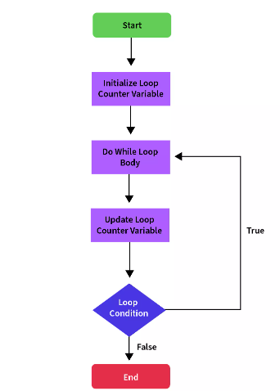
do-while Loop in C++

Slide 5
do-while Loop Examples:
1: Print numbers from 1 to 5
2: Keep asking for password until correct
#include <iostream>
using namespace std;
int main() {
int i = 1;
do {
cout << i << " ";
i++;
} while (i <= 5);
return 0;
}
#include <iostream>
using namespace std;
int main() {
int password;
do {
cout << "Enter password: ";
cin >> password;
} while (password != 1234);
cout << "Access Granted!" << endl;
return 0;
}

Slide 6
while Loop in C++
Key Points
Executes a block of code repeatedly as long as the condition is true.
The condition is checked before executing the loop body.
If the condition is false at the beginning, the loop body does not run at all.
Best used when the number of iterations is not known in advance.
Uses the while (condition) { } syntax.
No semicolon after the while(condition) line (unless loop is empty).
Syntax:
while (condition) {
// code block to be executed
}

Slide 7
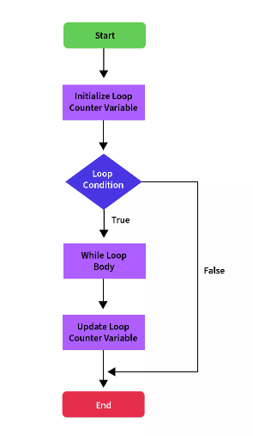
while Loop in C++

Slide 8
while Loop Examples:
1: Countdown from 5 to 1
2: Sum of first 5 natural numbers
#include <iostream>
using namespace std;
int main() {
int i = 5;
while (i >= 1) {
cout << i << " ";
i--;
}
return 0;
}
#include <iostream>
using namespace std;
int main() {
int i = 1, sum = 0;
while (i <= 5) {
sum += i;
i++;
}
cout << "Sum = " << sum;
return 0;
}

Slide 9
For Loop in C++
Key Points
Executes a block of code repeatedly for a specified number of times.
The condition is checked before each iteration.
The loop has initialization, condition, and update in one line.
Best used when the number of iterations is known in advance.
Uses the syntax: for (initialization; condition; update) { }
No semicolon after the for line (unless loop is empty).
Syntax:
for (initialization; condition; increment/decrement)
{
// code block to be executed if condition is true
}

Slide 10
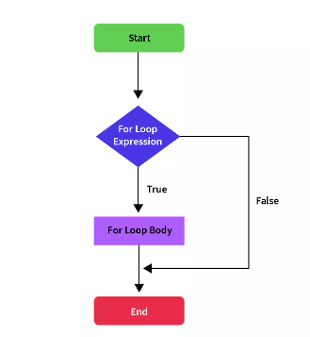
while Loop in C++

Slide 11
while Loop Examples:
1: Print even numbers from 2 to 10
2: Calculate factorial of 5
#include <iostream>
using namespace std;
int main() {
for (int i = 2; i <= 10; i += 2) {
cout << i << " ";
}
return 0;
}
#include <iostream>
using namespace std;
int main() {
int fact = 1;
for (int i = 1; i <= 5; i++) {
fact *= i;
}
cout << "Factorial of 5 is " << fact;
return 0;
}

Slide 12
Jumping Statements
Jumping statements are used to change the flow of execution by jumping from one part of the program to another.
These are helpful in controlling loops or exiting functions based on certain conditions.
They override the default top-to-bottom control flow in a C++ program.
Types of Jumping Statements
break
continue
return
goto

Slide 13
Jumping Statements
1 - break
Used to exit from a loop (for, while, do-while) or switch statement immediately.
Control moves to the next statement after the loop or switch.
#include <iostream>
using namespace std;
int main() {
for (int i = 1; i <= 5; i++) {
if (i == 3) {
cout << "Breaking the loop at i = " << i << endl;
break; // exits the loop
}
cout << "i = " << i << endl;
}
cout << "Loop exited using break." << endl;
return 0;
}

Slide 14
Jumping Statements
2 - continue
Used to skip the current iteration of a loop.
The loop continues from the next iteration, skipping remaining code inside the loop for that cycle.
#include <iostream>
using namespace std;
int main() {
for (int i = 1; i <= 5; i++) {
if (i == 3) {
cout << "Skipping i = " << i << endl;
continue; // skip the rest and go to next iteration
}
cout << "i = " << i << endl;
}
cout << "Loop completed using continue." << endl;
return 0;
}

Slide 15
Jumping Statements
3 - return
Used to exit a function and optionally return a value.
In main(), it is often used to return 0 to indicate successful program execution.
#include <iostream>
using namespace std;
int add(int a, int b) {
return a + b; // exits function and returns result
}
int main() {
int result = add(10, 20);
cout << "Sum = " << result << endl;
return 0; // exits main function
}

Slide 16
Jumping Statements
4 - goto
Used to jump to a labeled statement in the same function.
Can make code confusing and harder to maintain.
#include <iostream>
using namespace std;
int main() {
int x = 5;
if (x == 5) {
goto jump; // jumps to the label named jump
}
cout << "This line is skipped." << endl;
jump:
cout << "This is the jump label." << endl;
return 0;
}

Slide 17
Questions :
Print the multiplication table of any number (e.g., 7) from 1 to 10.
Print only odd numbers from 15 to 1 in reverse order.
Write a program to check whether a number is a prime number.
Write a program to find the sum of digits of a given number.
Write a program to reverse a number and check if it is a palindrome.
Write a program to find the factorial of a number using a loop.
Write a program to print all Armstrong numbers between 1 and 1000.
Write a program to check whether a number is a perfect number.
Write a program to count how many times digit 3 appears in a number.
Write a program to print the sum of all even numbers between 1 and 50.

